Slide 1
Memory Management
Case study (JVM & CLR)
Parameswari

Slide 2
C++ Memory Architecture Specification
HEAP
STACK
STATIC Area
CODE

Slide 3
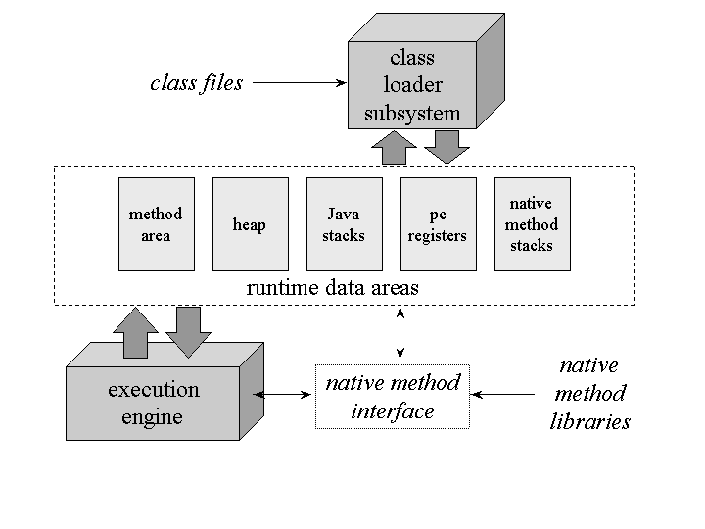
JVM Architecture Specification

Slide 4
Method Area
Type information
Field information
constant pool
Method Table
Reference to class loader and class Class
Method information
Class
variables

Slide 5
Method Area
Fully qualified type’s
name.
Fully qualified direct super
class name.
Whether class or an
interface
type's modifiers
list of the fully qualified
names of any direct super
interfaces
Type
Information
Constant
pool
Field
Informa
tion
Method
Informa-
tion
Class
variables
Ref. to
class loader
and class
Class
Method
Table

Slide 6
Method Area
Ordered set of constants
- string
- integer
- floating point
- final variables
symbolic references to
- types
- fields
- Methods
Constant Pool
Type
Informa
tion
Field
Informa
tion
Method
Informa-
tion
Class
variables
Ref. to
class loader
and class
Class
Method
Table

Slide 7
Method Area
field’s name
field’s type
field’s modifiers (subset )
- public
- private
- protected
- static
- final
- volatile
- transient
Field
Information
Type
Informa
tion
Constant
pool
Method
Informa-
tion
Class
variables
Ref. to
class loader
and class
Class
Method
Table

Slide 8
Method Area
Method’s name
Method’s return type
Number and type of
parameters
Modifiers (subset)
- public
- private
- protected
- static
- final
- synchronized
- native
- abstract
Type
Informa
tion
Constant
pool
Field
Informa
tion
Method
Table
Method
Information
Class
variables
Ref. to
class loader
and class
Class

Slide 9
Method Area
Type
Informa
tion
Constant
pool
Field
Informa
tion
ordered set of class
variables
- static variables
Method
Table
Method
Informa
tion
Class
variables
Ref. to
class loader
and class
Class

Slide 10
Method Area
Reference to class loader is used for dynamic linking.
instance java.lang.Class is created every type for
the following info.
- getName();
- getSuperClass();
- isInterface();
- getInterfaces();
- getClassLoader();
Type
Informa
tion
Constant
pool
Field
Informa
tion
Method
Table
Method
Informa
tion
Class
variables
Ref. to
Class loader
And class
Class

Slide 11
Method Area
Used for quick ref. to
method.
Contains name and index
in symbol ref. array
Type
Informa
tion
Constant
pool
Field
Informa
tion
Method
Table
Method
Informa
tion
Class
variables
Ref. to
class loader
and class
Class

Slide 12
Heap Memory
Objects and arrays are allocated in this area.
Two different threads of the same application, however, could trample on each other's heap data.

Slide 13
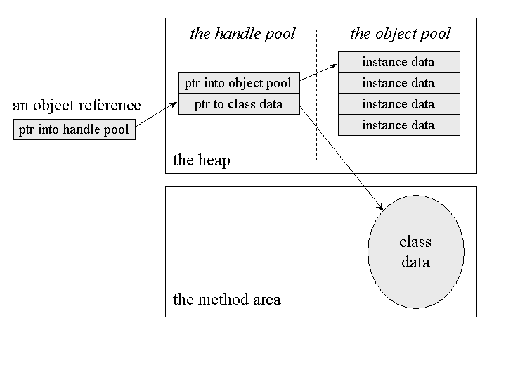
One possible Design of Object Allocation on Heap

Slide 14
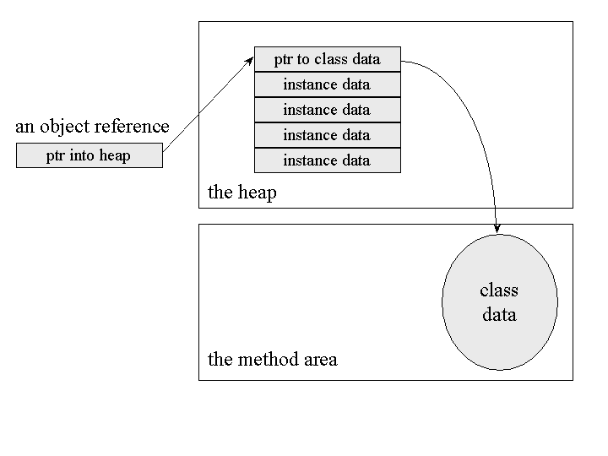
Another Design of Object Allocation

Slide 15
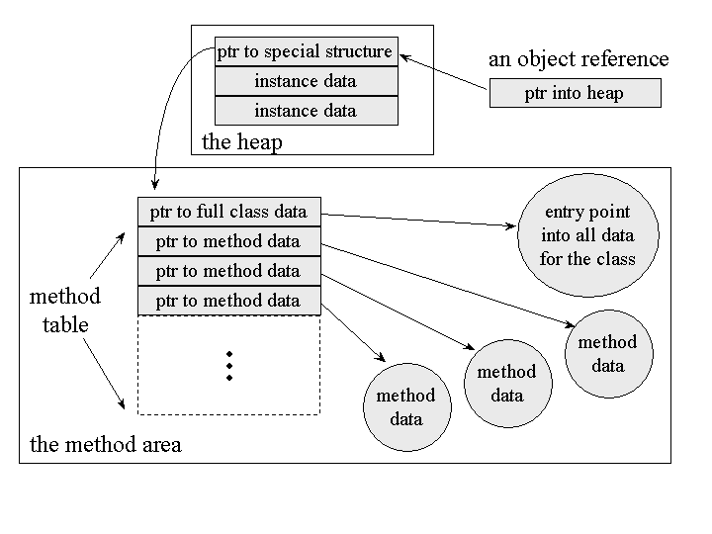
Another Design of Object Allocation

Slide 16
Lock on Objects
object is associated with a lock (or mutex) to coordinate multi-threaded access to the object.
Only one thread at a time can "own" an object's lock.
Once a thread owns a lock, it can request the same lock again multiple times, but then has to release the lock the same number of times before it is made available to other threads.

Slide 17
Array Allocation on Heap
The name of an array's class has one open square bracket for each dimension plus a letter or string representing the array's type.
The class name for an array of ints is "[I“.
The class name for three-dimensional array of bytes is "[[[B".
The class name for a two-dimensional array of Objects is "[[Ljava.lang.Object".

Slide 18
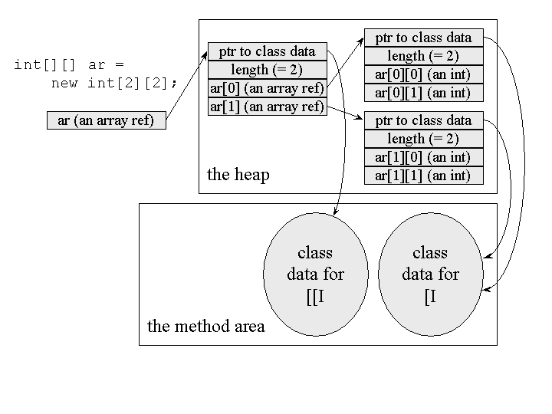
Design of allocation of array on Heap

Slide 19
Java Stack
Java stack stores a thread's state in discrete frames.
Each frame contains
- local variables Area.
- operand stack
- frame data

Slide 20
Java Stack
Stack Area generates when a thread creates.
It can be of either fixed or dynamic size.
The stack memory is allocated per thread.
It is used to store data and partial results.
It contains references to heap objects.

Slide 21
Java Stack
It also holds the value itself rather than a reference to an object from the heap.
The variables which are stored in the stack have certain visibility, called scope.

Slide 22
Local variable Area
organized as a zero-based array of cells.
Variables are accessed through their indices.
Values of type int, float, reference, and return Address occupy one cell.
Values of type byte, short, and char also occupy one cell.
Values of type long and double occupy two consecutive cells in the array.

Slide 23
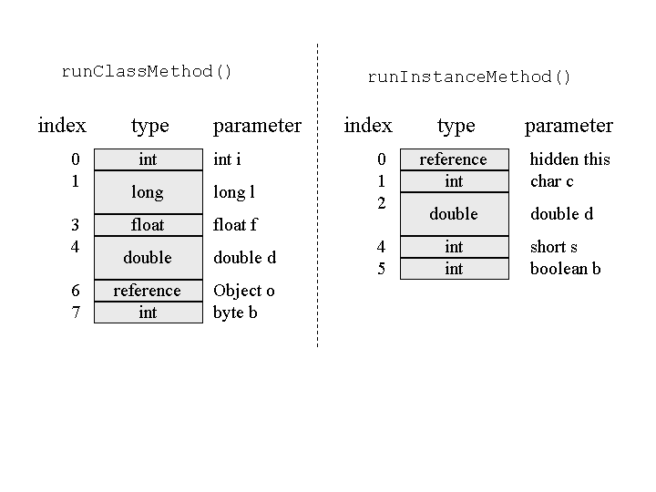
class Example3a {
public static int runClassMethod(int i, long l, float f, double d, Object o, byte b) {
return 0; }
public int runInstanceMethod(char c, double d, short s, boolean b) {
return 0; }
}

Slide 24
Operand Stack
operand stack is also organized as an array of cells.
local variables are accessed via array indices, the operand stack is accessed by pushing and popping values.
instructions take their operands from
- operand stack
- immediately following the opcode
- constant pool

Slide 25
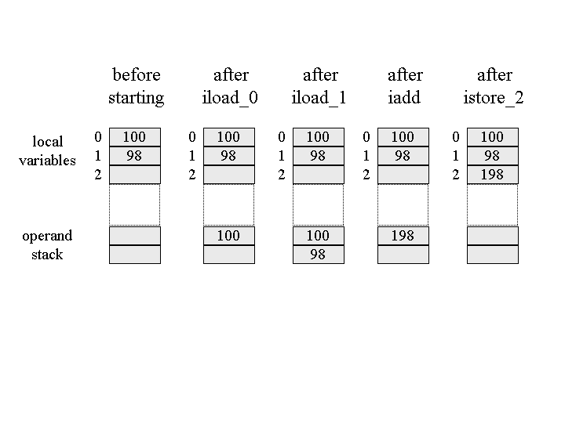
iload_0 // push the int in local variable 0
iload_1 // push the int in local variable 1
iadd // pop two ints, add them, push result
istore_2 // pop int, store into local variable 2

Slide 26
Stack Frame
Stack Frame: Stack frame is a data structure that contains the thread?s data. Thread data represents the state of the thread in the current method.
It is used to store partial results and data. It also performs dynamic linking, values return by methods and dispatch exceptions.

Slide 27
Stack Frame
When a method invokes, a new frame creates. It destroys the frame when the invocation of the method completes.
Each frame contains own Local Variable Array (LVA), Operand Stack (OS), and Frame Data (FD).

Slide 28
Stack Frame
The sizes of LVA, OS, and FD determined at compile time.
Only one frame (the frame for executing method) is active at any point in a given thread of control. This frame is called the current frame, and its method is known as the current method. The class of method is called the current class.

Slide 29
Stack Frame
The frame stops the current method, if its method invokes another method or if the method completes.
The frame created by a thread is local to that thread and cannot be referenced by any other thread.

Slide 30
Frame data
Frame data is needed to support
- constant pool resolution
- normal method return
- exception dispatch
- debugging.

Slide 31
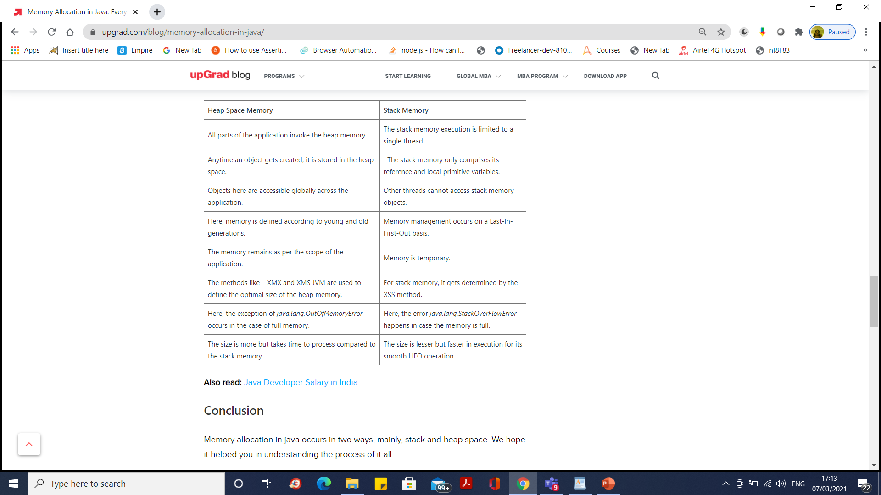

Slide 32
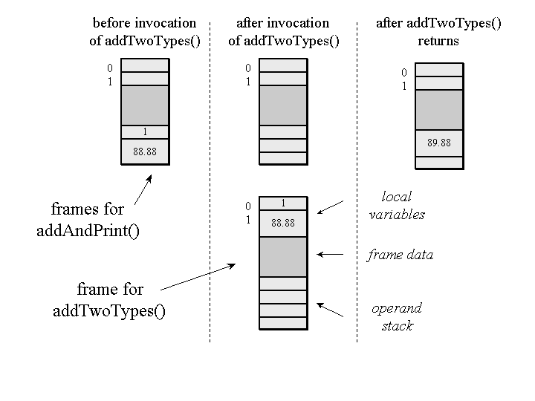
class Example3c {
public static void addAndPrint() {
double result = addTwoTypes(1, 88.88);
System.out.println(result);
}
public static double addTwoTypes(int i, double d) {
return i + d;
}
}

Slide 33
class abc {
public int a;
String str;
abc() {
a=10; atr=“string1”;
}
public void print{ System.out.print(a+” “+str); }
}
interface def {
void add();
}
class pqr extends abc implements def {
static int b;
final int c=50;
String s;
pqr(int m) { super(); b=m; s= new String(”string2”); }
void add() { a=a+c; add1(); }
static void add1() { c=b+50; }
}
Example

Slide 34
class Main {
public static void main(String[] s) {
pqr p=new pqr(20);
p.add();
p.print();
}
}

Slide 35
class abc {
public int a;
String str;
abc() {
a=10;
str=“string1”;
}
public void print{
System.out.print(a+” “+str);
}
}
Constant pool
Type info
abc
java.lang.Object
Isclass=true
modifier=4
Symbol ref. array
a
str
<init>
print
10 “string1”
Field info
name
Type
Modifier
index
a int 5 0
str String 4 1
Method info
name
ret.type
npar
modifier
parlist
codeptr
Method Table
Class variables
<init> void 0 1
name index
null
print void 0 5
<init>
2
print
3

Slide 36
Class Area of abc in Method area
Symbolic ref. array
abc
java.lang.Object
Isclass=true
modifier=4
name
Type
Modifier
index
a int 5 0
ptr. to interface list
str int 4 1
ptr. to symbolic ref. array
ptr to field info
name
ret.type
npar
modifier
parlist
codeptr
ptr to method info
<init> void 0 5
ptr to class variable list
print void 0 5
ref. to class loader
ref. to Class
Method name index in sym ref.
ptr to method table
<init>
2
print
3

Slide 37
interface def {
void add();
}
Type info
Constant pool
def
java.lang.Object
Isclass=false
modifier=4
Symbol ref. array
add
Class variables
Field info
Method info
null
null
name
ret.type
npar
modifier
parlist
codeptr
add void 0 4
Method Table
name index
add
0

Slide 38
Class Area of def in Method area
def
java.lang.Object
Isclass=false
modifier=4
Symbolic ref. array
ptr. to interface list
ptr. to symbolic ref. array
ptr to field info
name
ret.type
npar
modifier
parlist
codeptr
ptr to method info
add void 0 4
ptr to class variable list
ref. to class loader
ref. to Class
Method name index in sym ref.
ptr to method table
add
0

Slide 39
class pqr extends abc implements def {
static int b;
final int c=50;
String s;
pqr(int m) { super(); b=m;
s= new String(”string2”); }
void add() { a=a+c; add1(); }
static void add1() { c=b+50; }
}
Type info
Class variables
pqr
abc
Isclass=true
modifier=4
b
Field info
Constant pool
name
Type
Modifier
index
Symbolic ref. array
b int 4,6 0
b
c
s
<init>
super
add
add1
c int 4,7 1
50
S String 4 2
Method info
Method Table
name
ret.type
npar
modifier
parlist
codeptr
name index
<init> void 1 4
<init>
3
add void 0 4
add
5
add1 void 0 4
add1
6
super void 0 4
super
4

Slide 40
Class Area of pqr in Method area
Symbolic ref. array
pqr
abc
Isclass=true
modifier=4
name
Type
Modifier
index
b int 4,6 0
ptr. to interface list ( to def)
c int 4,7 1
ptr. to symbolic ref. array
S String 4 2
ptr to field info
name
ret.type
npar
modifier
parlist
codeptr
ptr to method info
<init> void 1 4
ptr to class variable list (b)
add void 0 4
add1 void 0 4
ref. to class loader
super void 0 4
ref. to Class
Method name index in sym ref.
ptr to method table
<init>
3
add
4

Slide 41
class Main {
public static void main(String[] s) {
pqr p=new pqr(20);
p.add();
p.print();
}
}
Type info
Constant pool
Main
java.lang.Object
Isclass=true
modifier=4
Symbol ref. array
main
20
Class variables
Field info
Method info
null
name
ret.type
npar
modifier
parlist
null
codeptr
main void 0 4
Method Table
name index
main
0

Slide 42
Class Area of Main in Method area
Main
java.lang.Object
Isclass=true
modifier=4
Symbolic ref. array
ptr. to interface list
ptr. to symbolic ref. array
ptr to field info
name
ret.type
npar
modifier
parlist
codeptr
ptr to method info
main void 0 5,6
ptr to class variable list
ref. to class loader
ref. to Class
Method name index in sym ref.
ptr to method table
main
0

Slide 43
Main
pqr
abc
Main
Main
Main
pqr
p
str
stack
p
main
main
s
Heap
a,b,c
string2
Main
pqr
pqr
Main
pqr
Main
p
p
p
main
Pqr.<init>
Pqr.<init>
abc.<init>

Slide 44
Main
pqr
abc
Main
pqr
abc
pqr
abc
Main
p
str
p
str
str
p
s
s
s
add
add
a,b,c
add1
string2
string2
a,b,c
a,b,c
string2
Main
pqr
abc
Main
pqr
abc
p
str
p
str
s
s
str
s
print
a,b,c
string2
string2
a,b,c

Slide 45
Relation between C++ memory structure and JVM memory structure

Slide 46
Constant
pool
STATIC Area
CODE
Field
Informa
tion
Class
variables
Method
Area
Type
Informa
tion
Metadata
Method
Informa
tion
Ref. to
class loader
and class
Class
Method
Table

Slide 47
Garbage collection
JVM Heap
C++ Heap

Slide 48
Frame data
Operand
Stack
Threaded
JVM
Stack
JVM stack
Threads
C++ stack

Slide 49
Responsibilities of Memory Mgr
Chop the chunk.
Allocate Requested number of bytes.
Provide necessary information to garbage
collector.
Collect the bytes returned by garbage
collector.
Defragment the chunks.

Slide 50
Design Choices
How to allocate bytes
- Contiguous memory allocation.
- Non contiguous memory allocation.
How many bytes to be allocated
- exact requested number of bytes.
- Allocate bytes in terms of 2^n (Buddy System).
How defragmentation to be done
- Compaction.
- Buddy system.

Slide 51
JVM Memory Manager
Algorithms Followed
Noncontiguous Memory Allocation.
First fit to choose approperiate chunk.
Buddy system to chop a chunk.
Buddy system for defragmentation.

Slide 52
How to implement memory manager
Need of 4 threads
- Memory allocator.
- Memory Defragmenter.
- Chunk cleaner.
- Data manager.

Slide 53
When VM requests m bytes
Allocator
1. Checks for first chunk with size
>=m+4.
2. If available chops it and returns to VM
else requests OS for new chunk.
Data Manager inserts an entry in Memory
Allocation Table (for garbage collector ).
Starting address
Size requested
Size Allocated

Slide 54
Garbage Collection
For each entry in MA Table GC moves to starting address+ size requested address,
checks the ref. count. If zero returns the index of table entry to Data Manager.
Data Manager deletes the entry from MAT
and adds in Defragment Table.
For each entry in Defragment Table,
Defragmenter combines the consecutive
fragments.
Starting Address
Size

Slide 55
Design problem
VM requests an array of bytes
- to store data in Method Area.
- for stack frame.
- for object on Heap.
MM doesn’t know the purpose of bytes.
How does MM allocates memory in three
different address spaces for different type of
requests.
Use Three MMs. Each MM has its own addr. Space. Its responsibility of VM to direct the requests to appropriate MM.

Slide 56
Optimal size of chunk
For Method Area MM 10K
For Stack 16K
For Heap
1K, 10K, 32K
Initial State of Chunk pool
Trade off between performance and
efficient memory usage.
first and top pointers of each pool is set to null

Slide 57
Chunk Pool cleaner
similar to Garbage collector.
For every 5s cleaner returns all chunks more than 5.

Slide 58
ClR Memory Management

Slide 59
CLR Names to Memory Areas
Method Area as Type Area
Stack as Roots
Heap as Heap, but two heaps
- Managed heap
- Unmanaged heap
In JVM entire heap is managed.

Slide 60
Necessity of Unmanaged Heap
M/C 1
JVM
Java
M/C 2
M/C 1
C#
CLR
VB
M/C 2
Some Languages allow pointers. So to support pointers Unmanaged heap is supported

Slide 61
What is the difference
JVM MM
- Allocation is complex.
- Defragmentation is simple.
ClR MM
- Allocation is simple.
- Defragmentation is complex.

Slide 62
JVM Memory Manager
Algorithms Followed
Contiguous Memory Allocation.
Compaction for defragmentation.
Lazy Defragmenter

Slide 63
Memory Managers
Type Memory manager.
Roots Memory manager.
Managed heap manager.
Unmanaged heap manager.
GC runs.
No GC.
GC runs.
No GC.
To deallocate Unmanaged Memory Finalizers should be used.

Slide 64
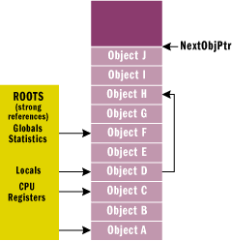
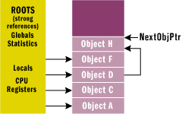
Before GC
After GC
Memory Allocation
Next Ptr
Obj 3
Obj 2
Obj 1

Slide 65
Thank You

